Slide 1
Investment Appraisal Brief
High-Rise Green Office Tower Vs. Net-Zero Community Housing Project

Slide 2
Summary Metrics
The Green Office Tower delivers a positive NPV and a substantially higher IRR than the Net-Zero Housing project.
Metric | Green Office Tower | Net-Zero Housing
NPV | $168,560.74 | -$179,848.78
IRR | 14.02% | 2.81%
Payback Period | 4.35 years | +5.00 years
NRV | $580,000.00 | $100,000.00
The payback period for the Tower is shorter (4.35 years versus +5 years), indicating quicker cash flow recovery.
The NRV further supports the value proposition of the Tower with $580,000 compared to only $100,000 for the Housing project.

Slide 3
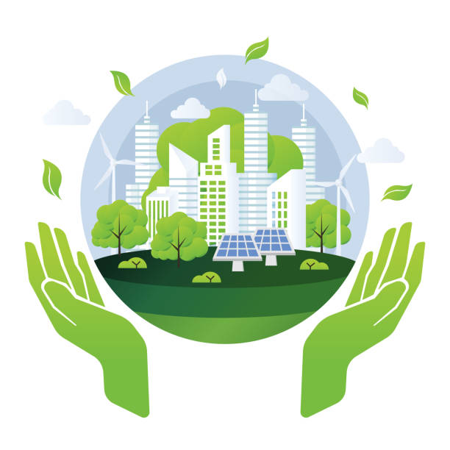
Strategic Analysis
The Net-Zero Housing project is fully aligned, delivering complete carbon neutrality and reinforcing the firm’s long-term environmental commitments.
The Green Office Tower is financially safer in the short term, with a payback period of 4.35 years and stronger early-stage cash flow.
The Net-Zero Housing project could enhance brand reputation, attract ESG-conscious customers and investors, and position the company for future green market opportunities.
Pursuing the Net-Zero Housing project may reinforce the firm’s identity as a global ESG leader. However, strategic ESG messaging could also be supported by integrating sustainable features into the Tower project or publicly committing to future net-zero initiatives.

Slide 4
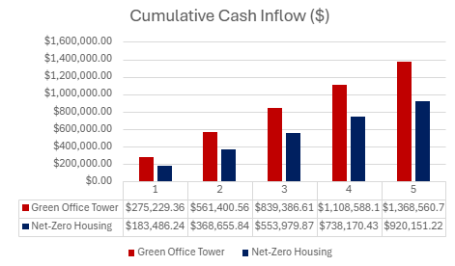
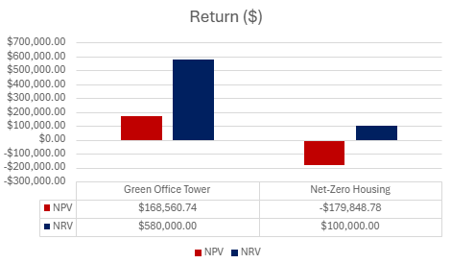
Recommendation & Justification
The Green Office Tower is strongly recommended on financial grounds, achieving a positive NPV of $168,560.74, an IRR of 14.02% and a payback period of 4.35 years, while also offering greater safety if liquidity is constrained over the next three years. The Net-Zero Housing project, although fully aligned with the Net-Zero 2040 goal and poised to enhance reputation, attract ESG investors and unlock green-finance opportunities, posts a negative NPV, an IRR of just 2.81% and a five-year payback. Unless priorities such as boosting ESG scores, strengthening brand value or entering the sustainable-housing sector become critical, the Green Office Tower remains the more prudent choice; if those objectives take precedence, Net-Zero Housing may merit support.

Slide 5
Next Steps
Conduct further due diligence for both projects.
Explore opportunities to integrate supplementary ESG initiatives alongside the Tower project, ensuring that environmental goals are still actively pursued.
Engage with stakeholders to confirm that the strategic focus aligns with the board’s vision and priorities.

